Slide 2
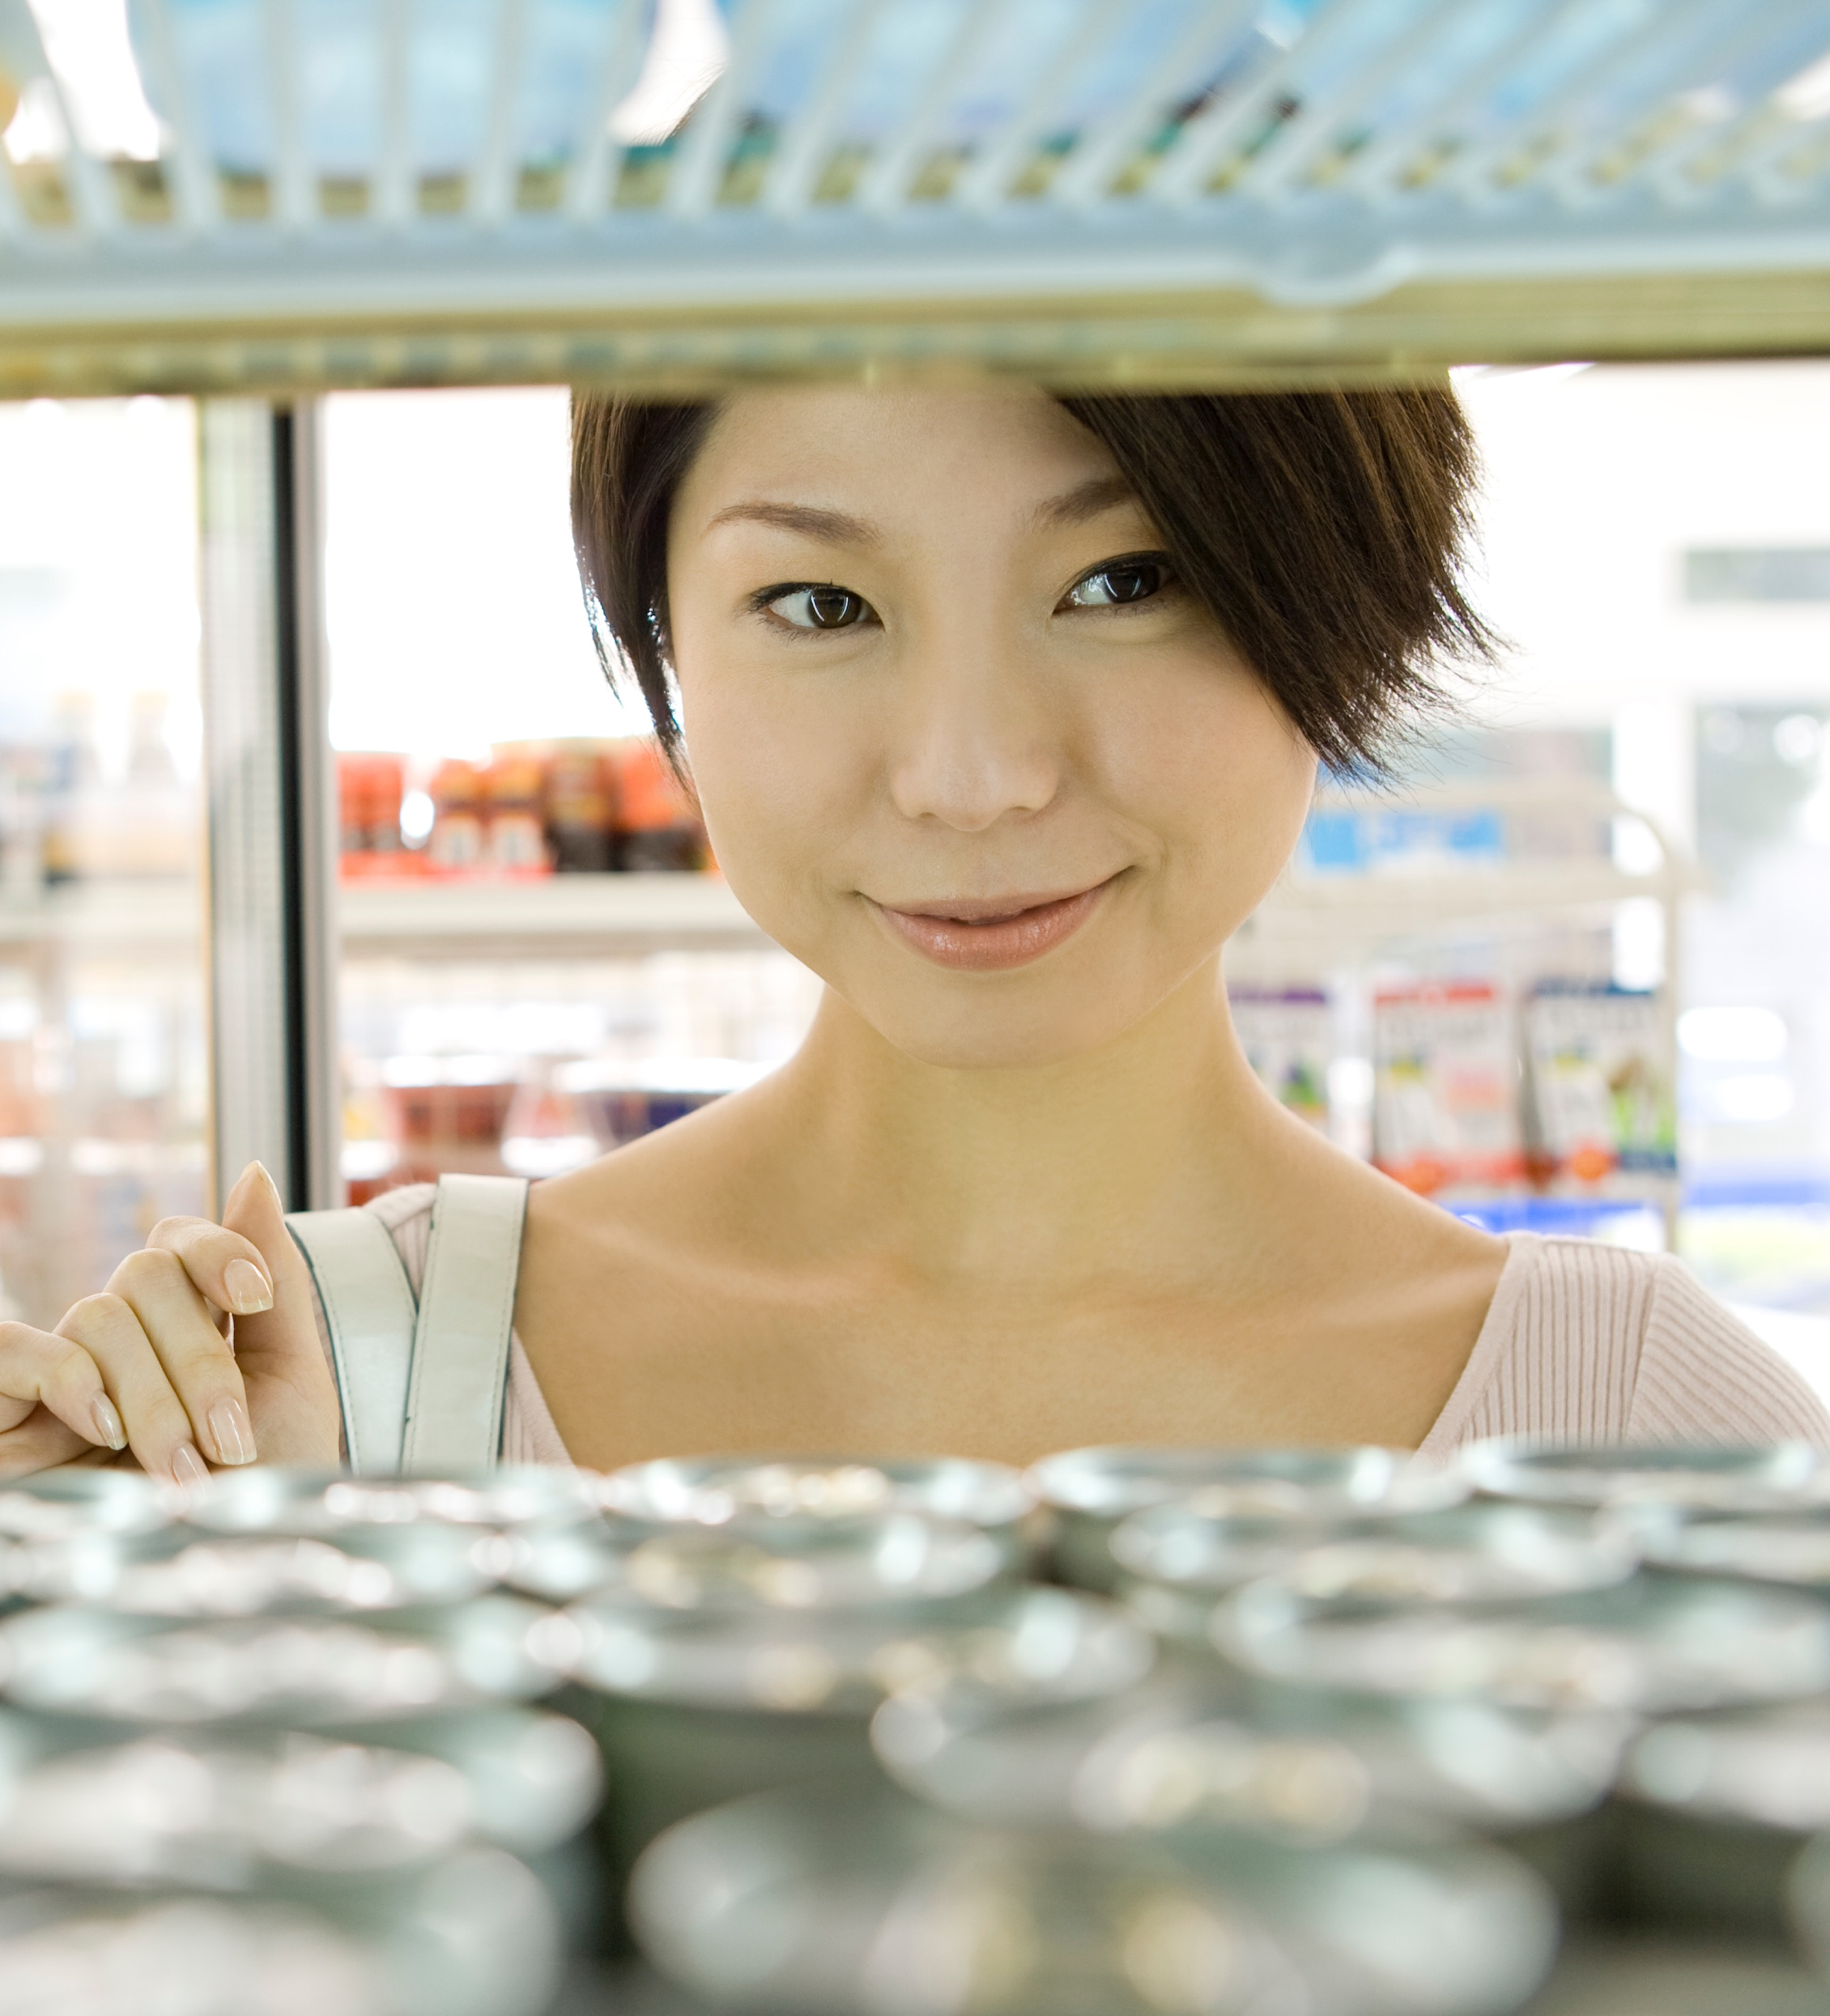
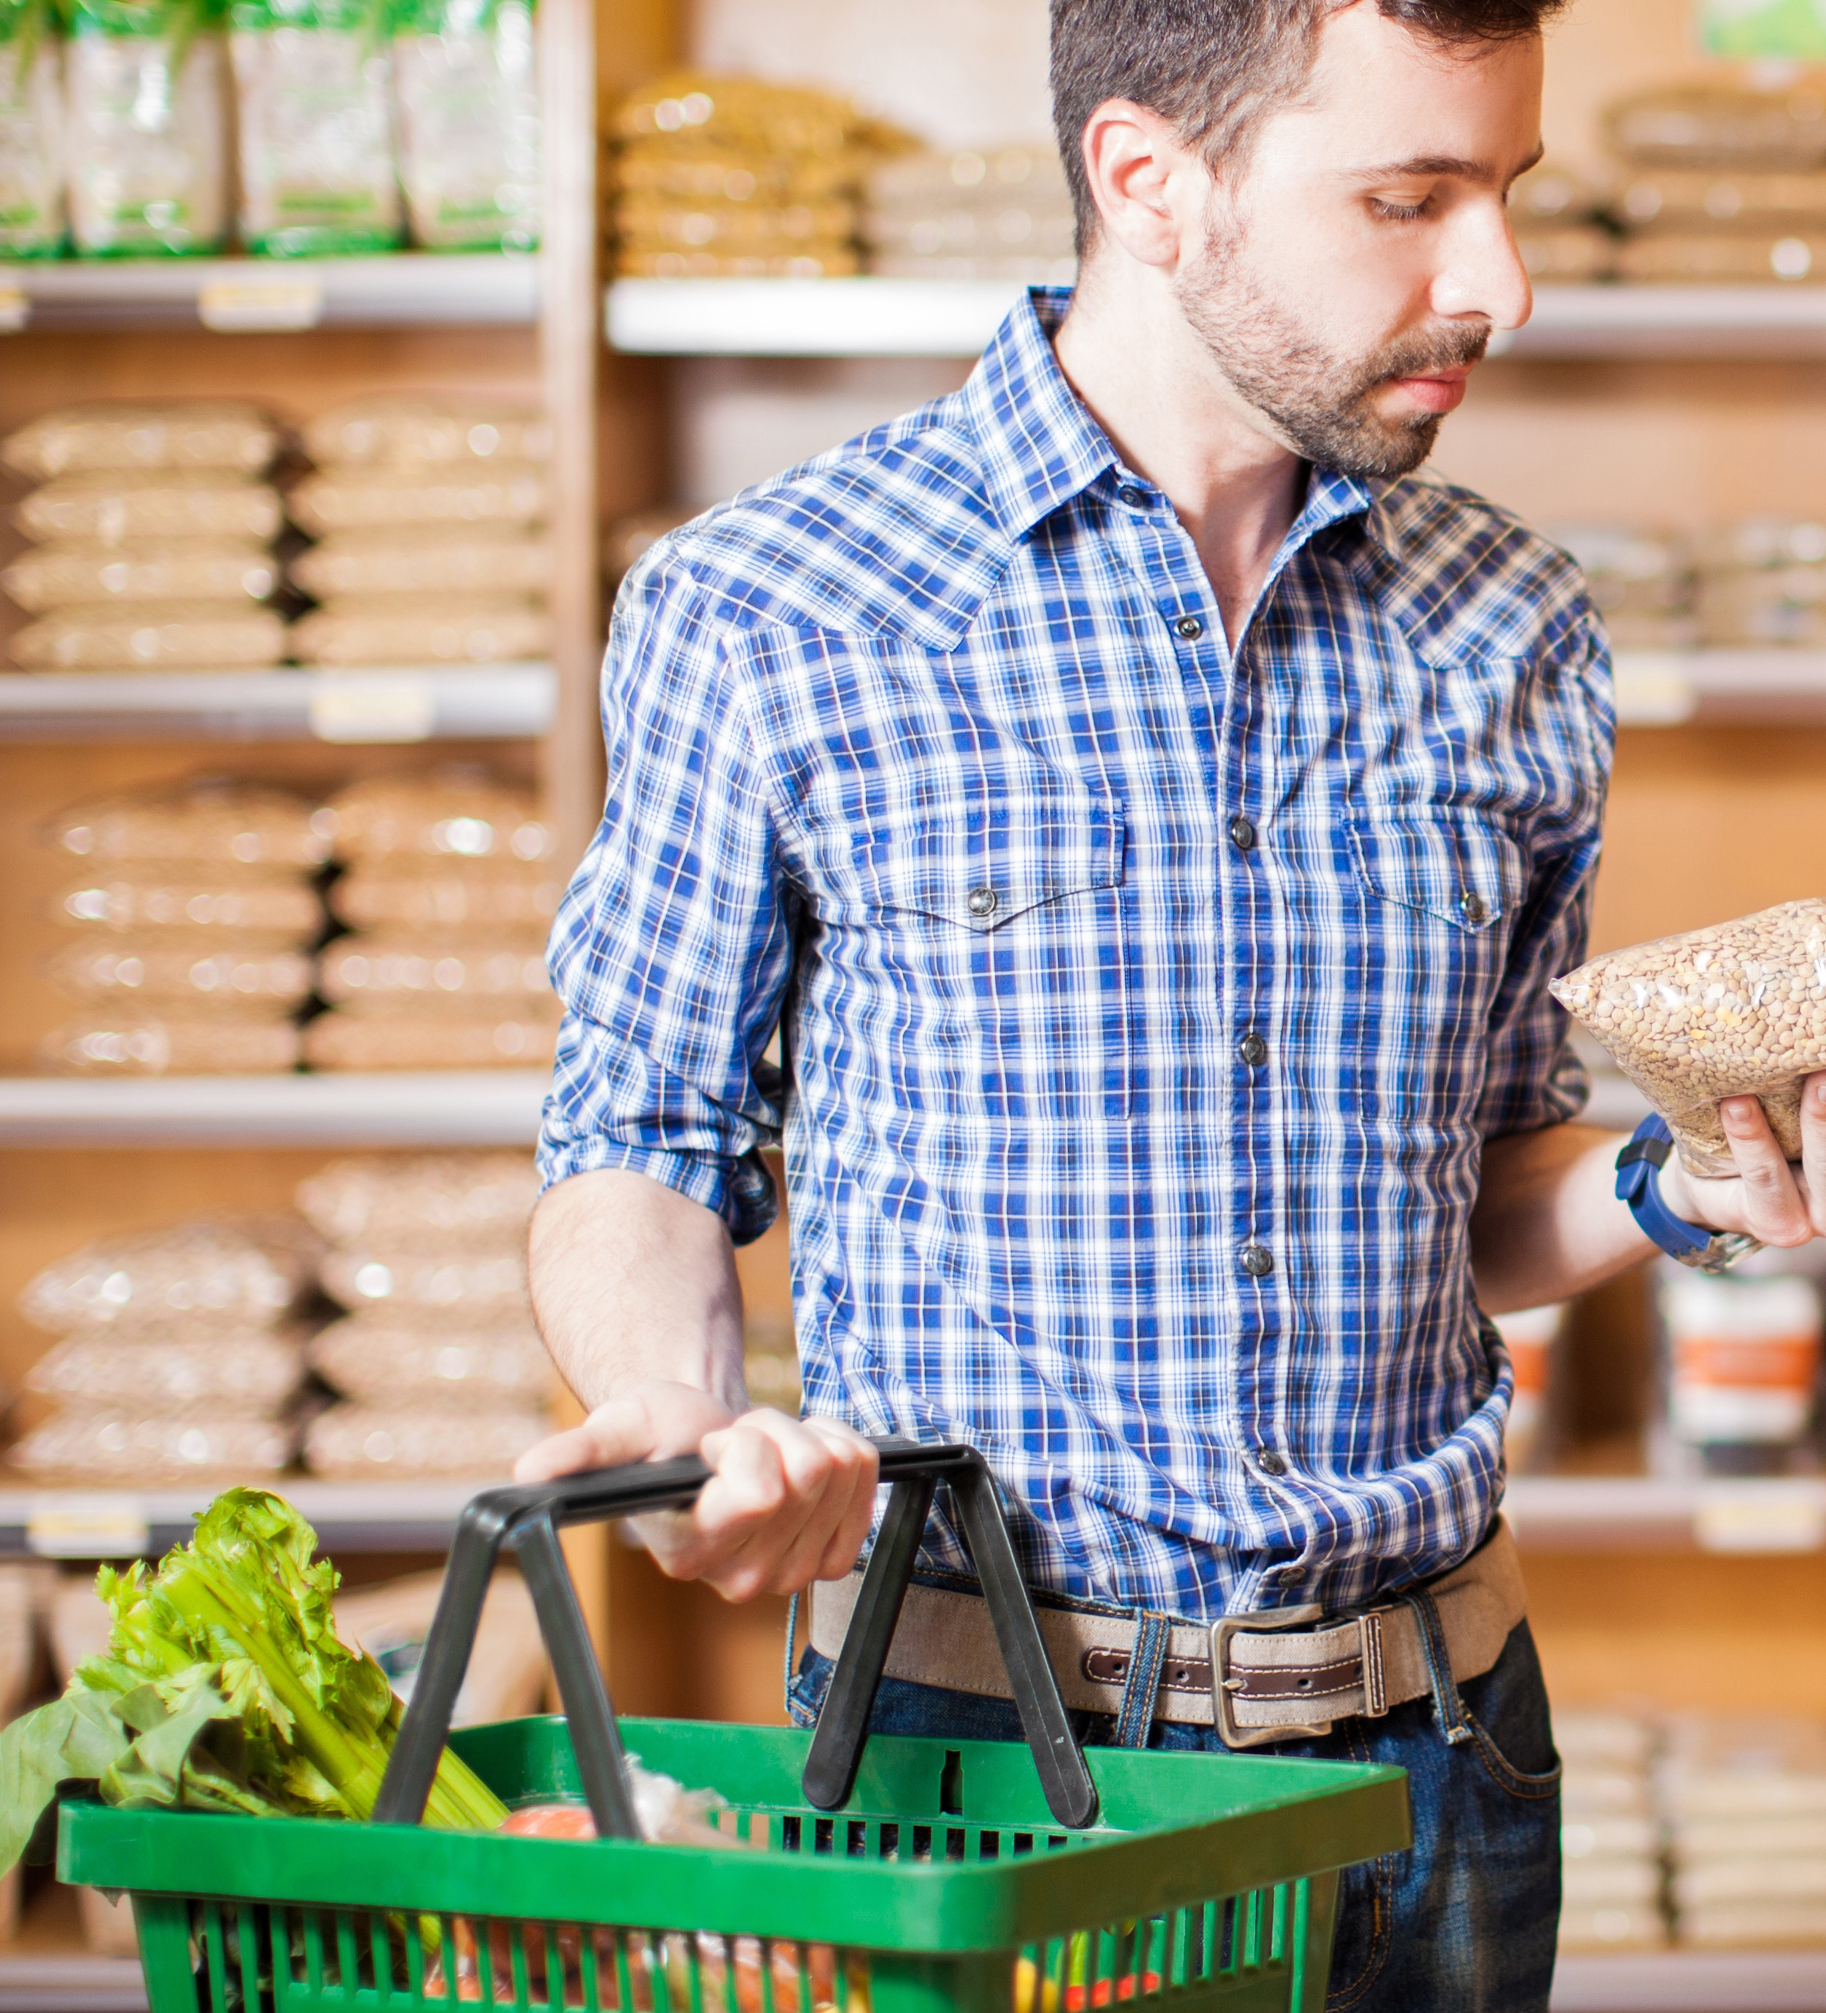
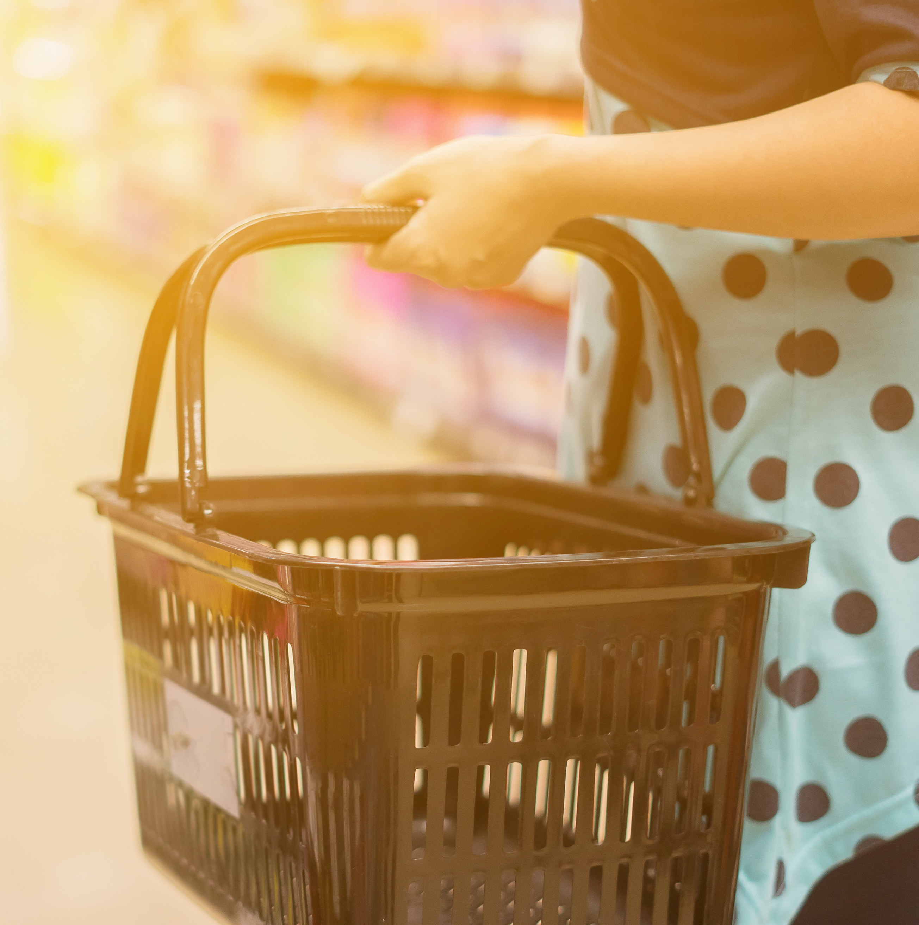
What’s the Opportunity for Plus+1?
Shopper
Trip
Basket

Slide 3

Select Your Target Shopper
Teen & Young Adult
Older Millennial
Blue Collar Male
Low
Income
Multicultural
All Shoppers

Slide 4
Where are you located?
New England
Pacific
West North Central
Middle Atlantic
Mountain
East North Central
South Atlantic
East South Central
West South Central
All Regions

Slide 5
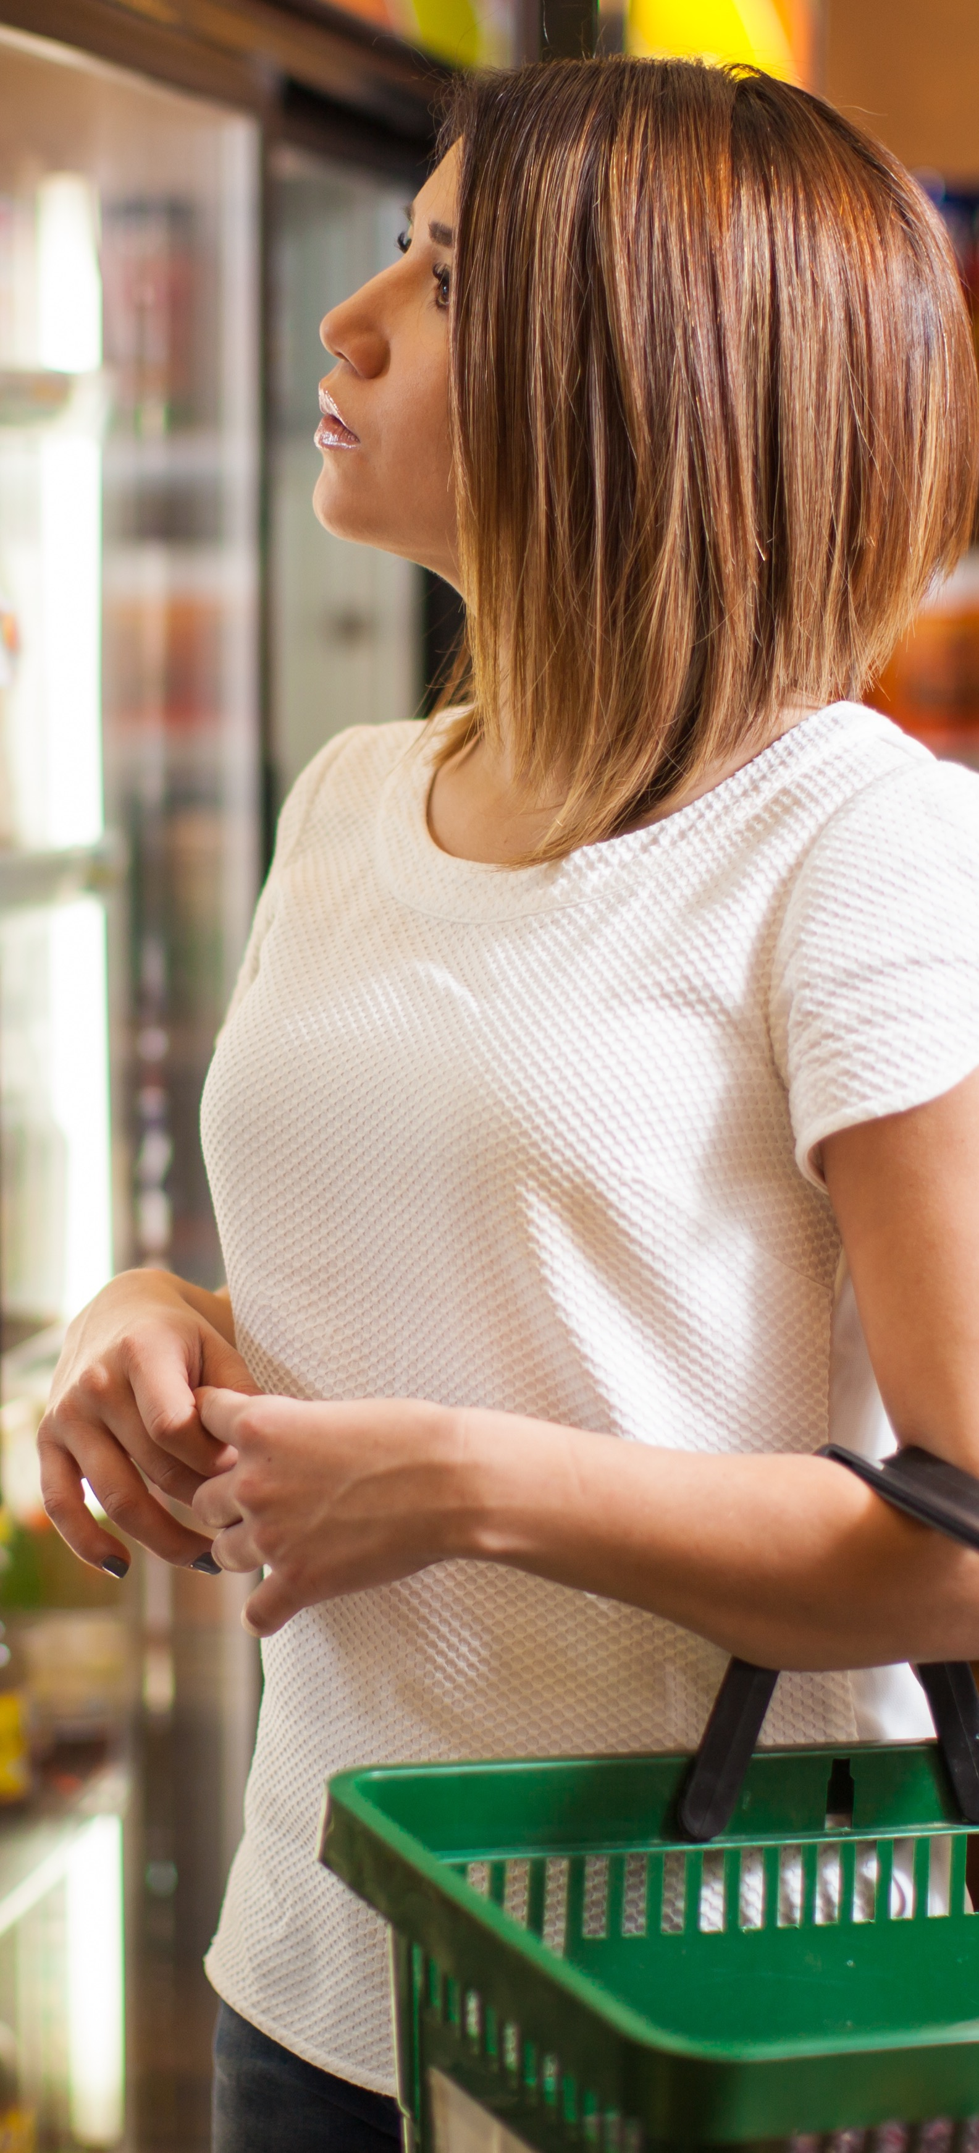


Shopper Profile
Older Millennial
East South Central
Gender
Ethnicity
White | African American | Hispanic | Asian | Other
73.24% | 20.59% | 4.35% | 0% | 1.82%
+16.1 | +5.7 | -18.3 | -3.1 | -0.3
Age Groups
Martial Status
Socioeconomic Levels
43.71% | Married
6.11% | 2.7
Single Low Income
Household Size
15.58% |
Living with Partner
43.6% | 18.4
Strugglers
15.31% | +2.1
1 Person in HH
33.96% |
Single/Never Married
32% | -6.8
Middle Class
28.15% | +3.1
2 Persons in HH
0% |
Separated
18.29% | -14.3
Affluent
56.54% | -5.2
3+ Persons in HH

Slide 6
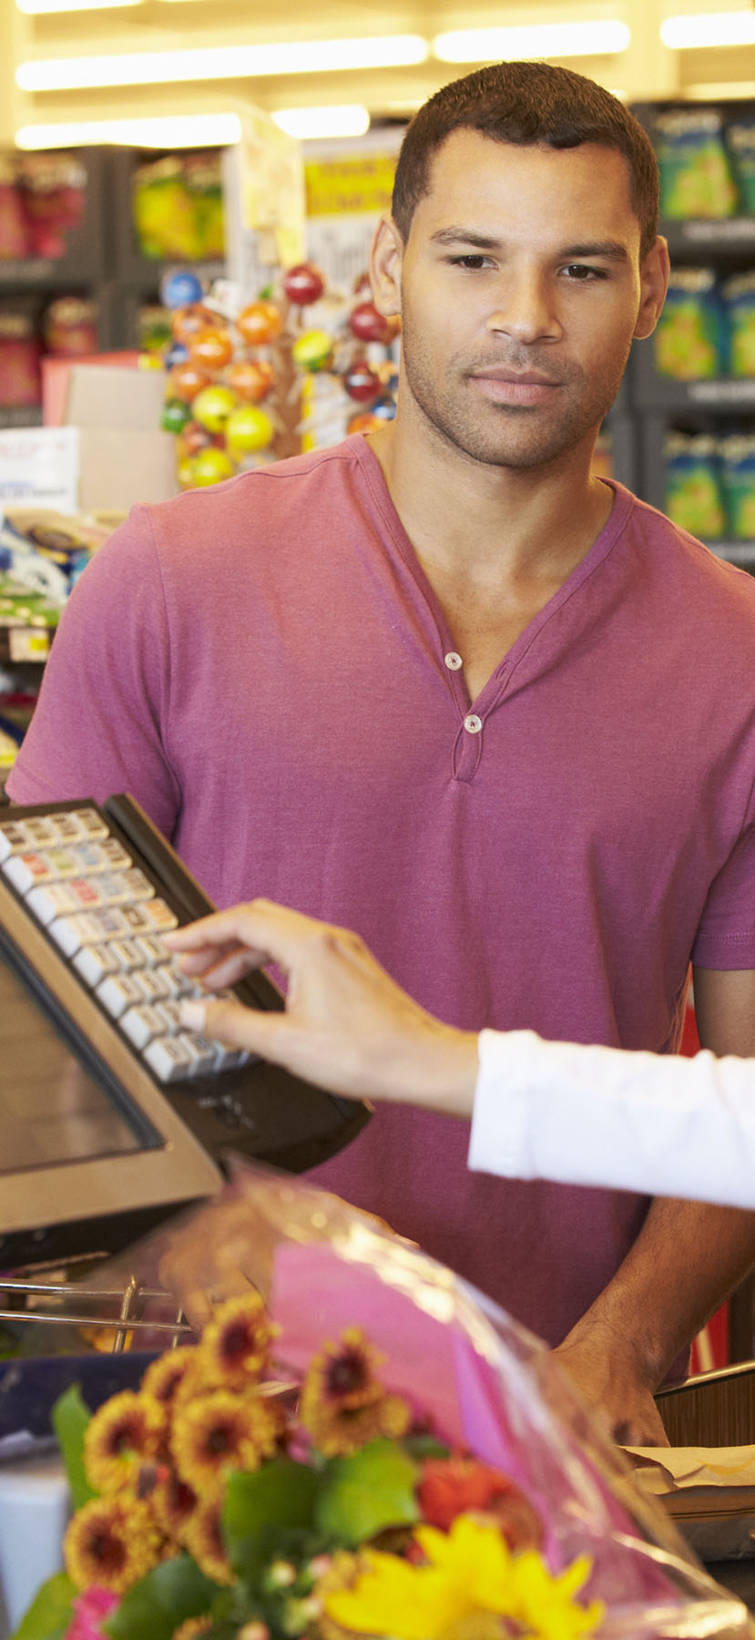







Path to Purchase
Race
Older Millennial
East South Central
Time of Day
34.47% | Morning (6am-11am) -1.0
10.57% | Mid-day (11am-2pm) -3.6
19.91% | Afternoon (2pm-5pm) +3.3
28.45% | Evening (5pm-10pm) +4.6
6.61% | Night (10pm-6am) -3.4
Location Prior to Trip
54.71% | Home
Pre-Shop Weekday or Weekend
77.36% | Weekday +5.2
22.64% | Weekend -5.2
Trip Mission
Destination
Item
Planning
30.84% | -2.6
Grab and Go
33.85% | Planned -4.1
4.84% | Prepared for Trip
28.16% | +5.2
Gasoline/
Diesel
18.21% | -5.8
Grab and Go Home
Who With
69.15% | Alone +6.4
6.26% | -1.7
Coffee
18.12% | +5.7
Need It Now
Reason for Store Choice
76.39% | Get in and out Quickly +4.2
1.29% | -2.6
Lottery
Tickets
30.23% | +4.8
Fill in Non-Food
Consideration
11.21% | Considered other stores +1.0

Slide 7
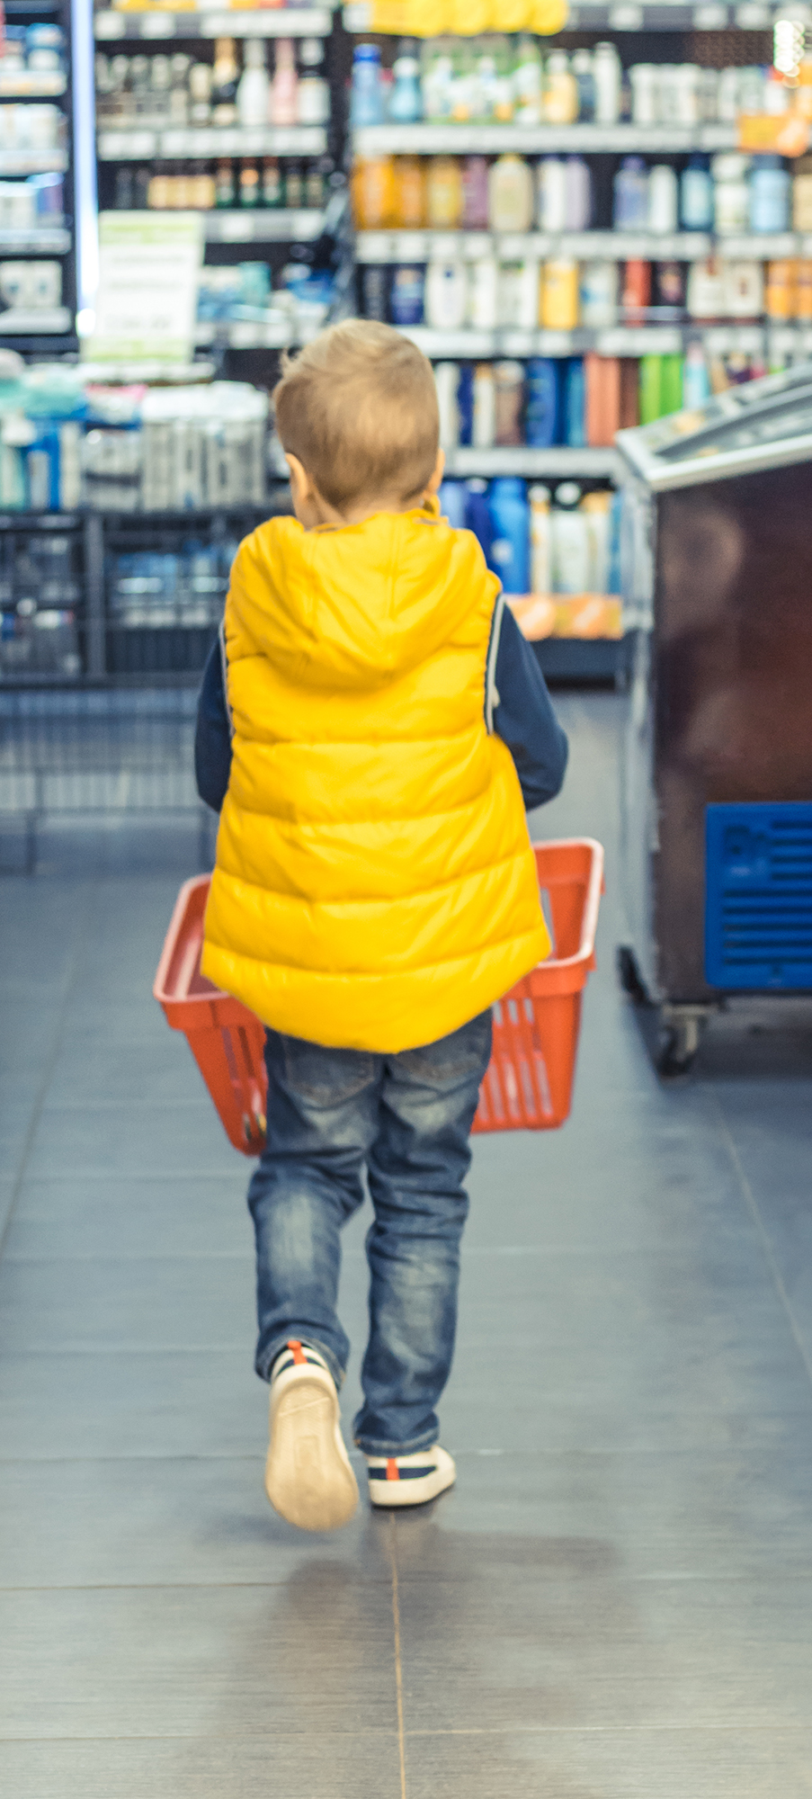



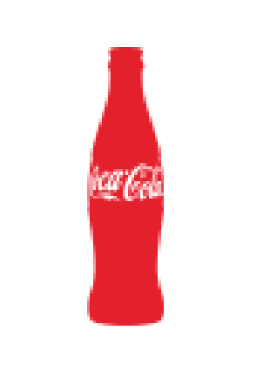

In-Store Behavior
Older Millennial
East South Central
Purchased
NARTD
Immediate
Consumption
Time Spent
60.78% | +2.3
65.22% | IC Food/Bev in Basket -6.0
35.2% | +3.5
4-5 minutes
Basket Summary
Overall Satisfaction
63.51% | +1.9
Beverages
$9.7 9 | -89.0
Average
Dollars Spent
per Basket
27.05% | -5.3
Food Items
1.93 | -9
Average Number of Items per Basket
3.89% | -6.2
Lottery Tickets
92.52% | +0.5
Satisfied (Top 2 Box)
Satisfaction Drivers
Post-Shop Location After Trip
$
Product
Selection
92.7% | +6.5
Product
Pricing
87.2% | +4.9
Service by
Employees
94.8% | +5.7
Check-out
Experience
91% | +1.4
Overall Store
Atmosphere
88.5% | +2.9
Ease of
Shopping
91.5% | -0.4
52.41% |
Home

Slide 8
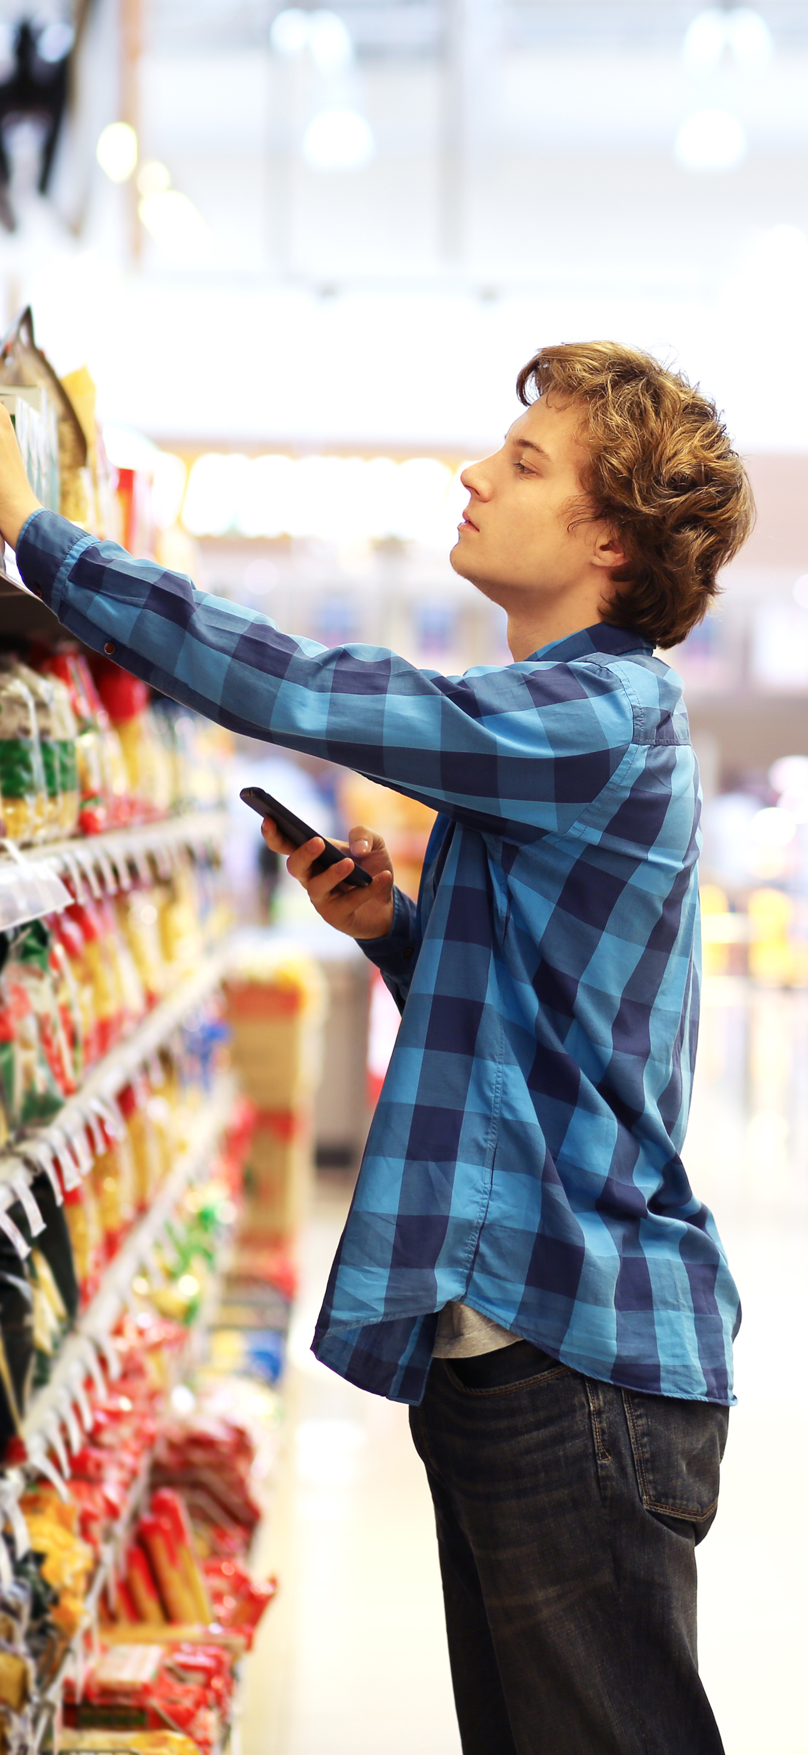
Top 2 Box
Older Millennial
East South Central
Get In and Out Quickly
Buy Beverage to Drink Now
Closest Store That Had What I Needed
Attitudinal Statements
Easily Find Items I Needed
Buy All Items Needs in One Trip
Get Best Overall Value Possible
Buy Meal/Snack to Eat Now
Save as Much Money as Possible
Buy Fuel For Car
Prefer/Buy High-quality Products

Slide 9
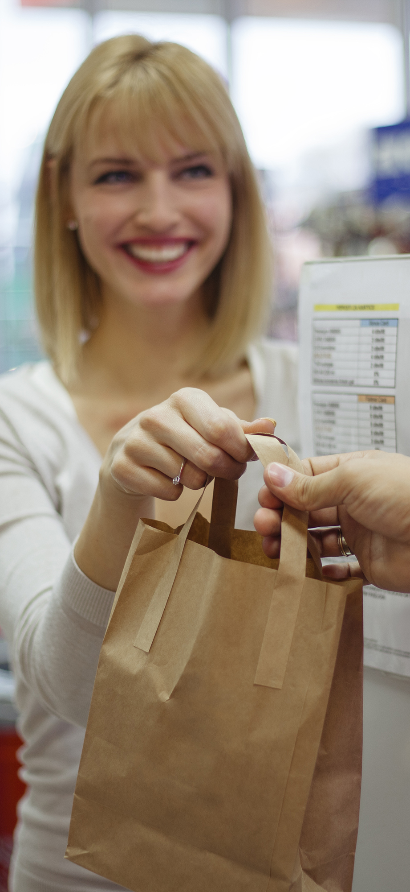
Older Millennial
East South Central
$1.4M
$1.9M
Revenue Per Store
$2.4M
$2.9M
$3.4M

Slide 10
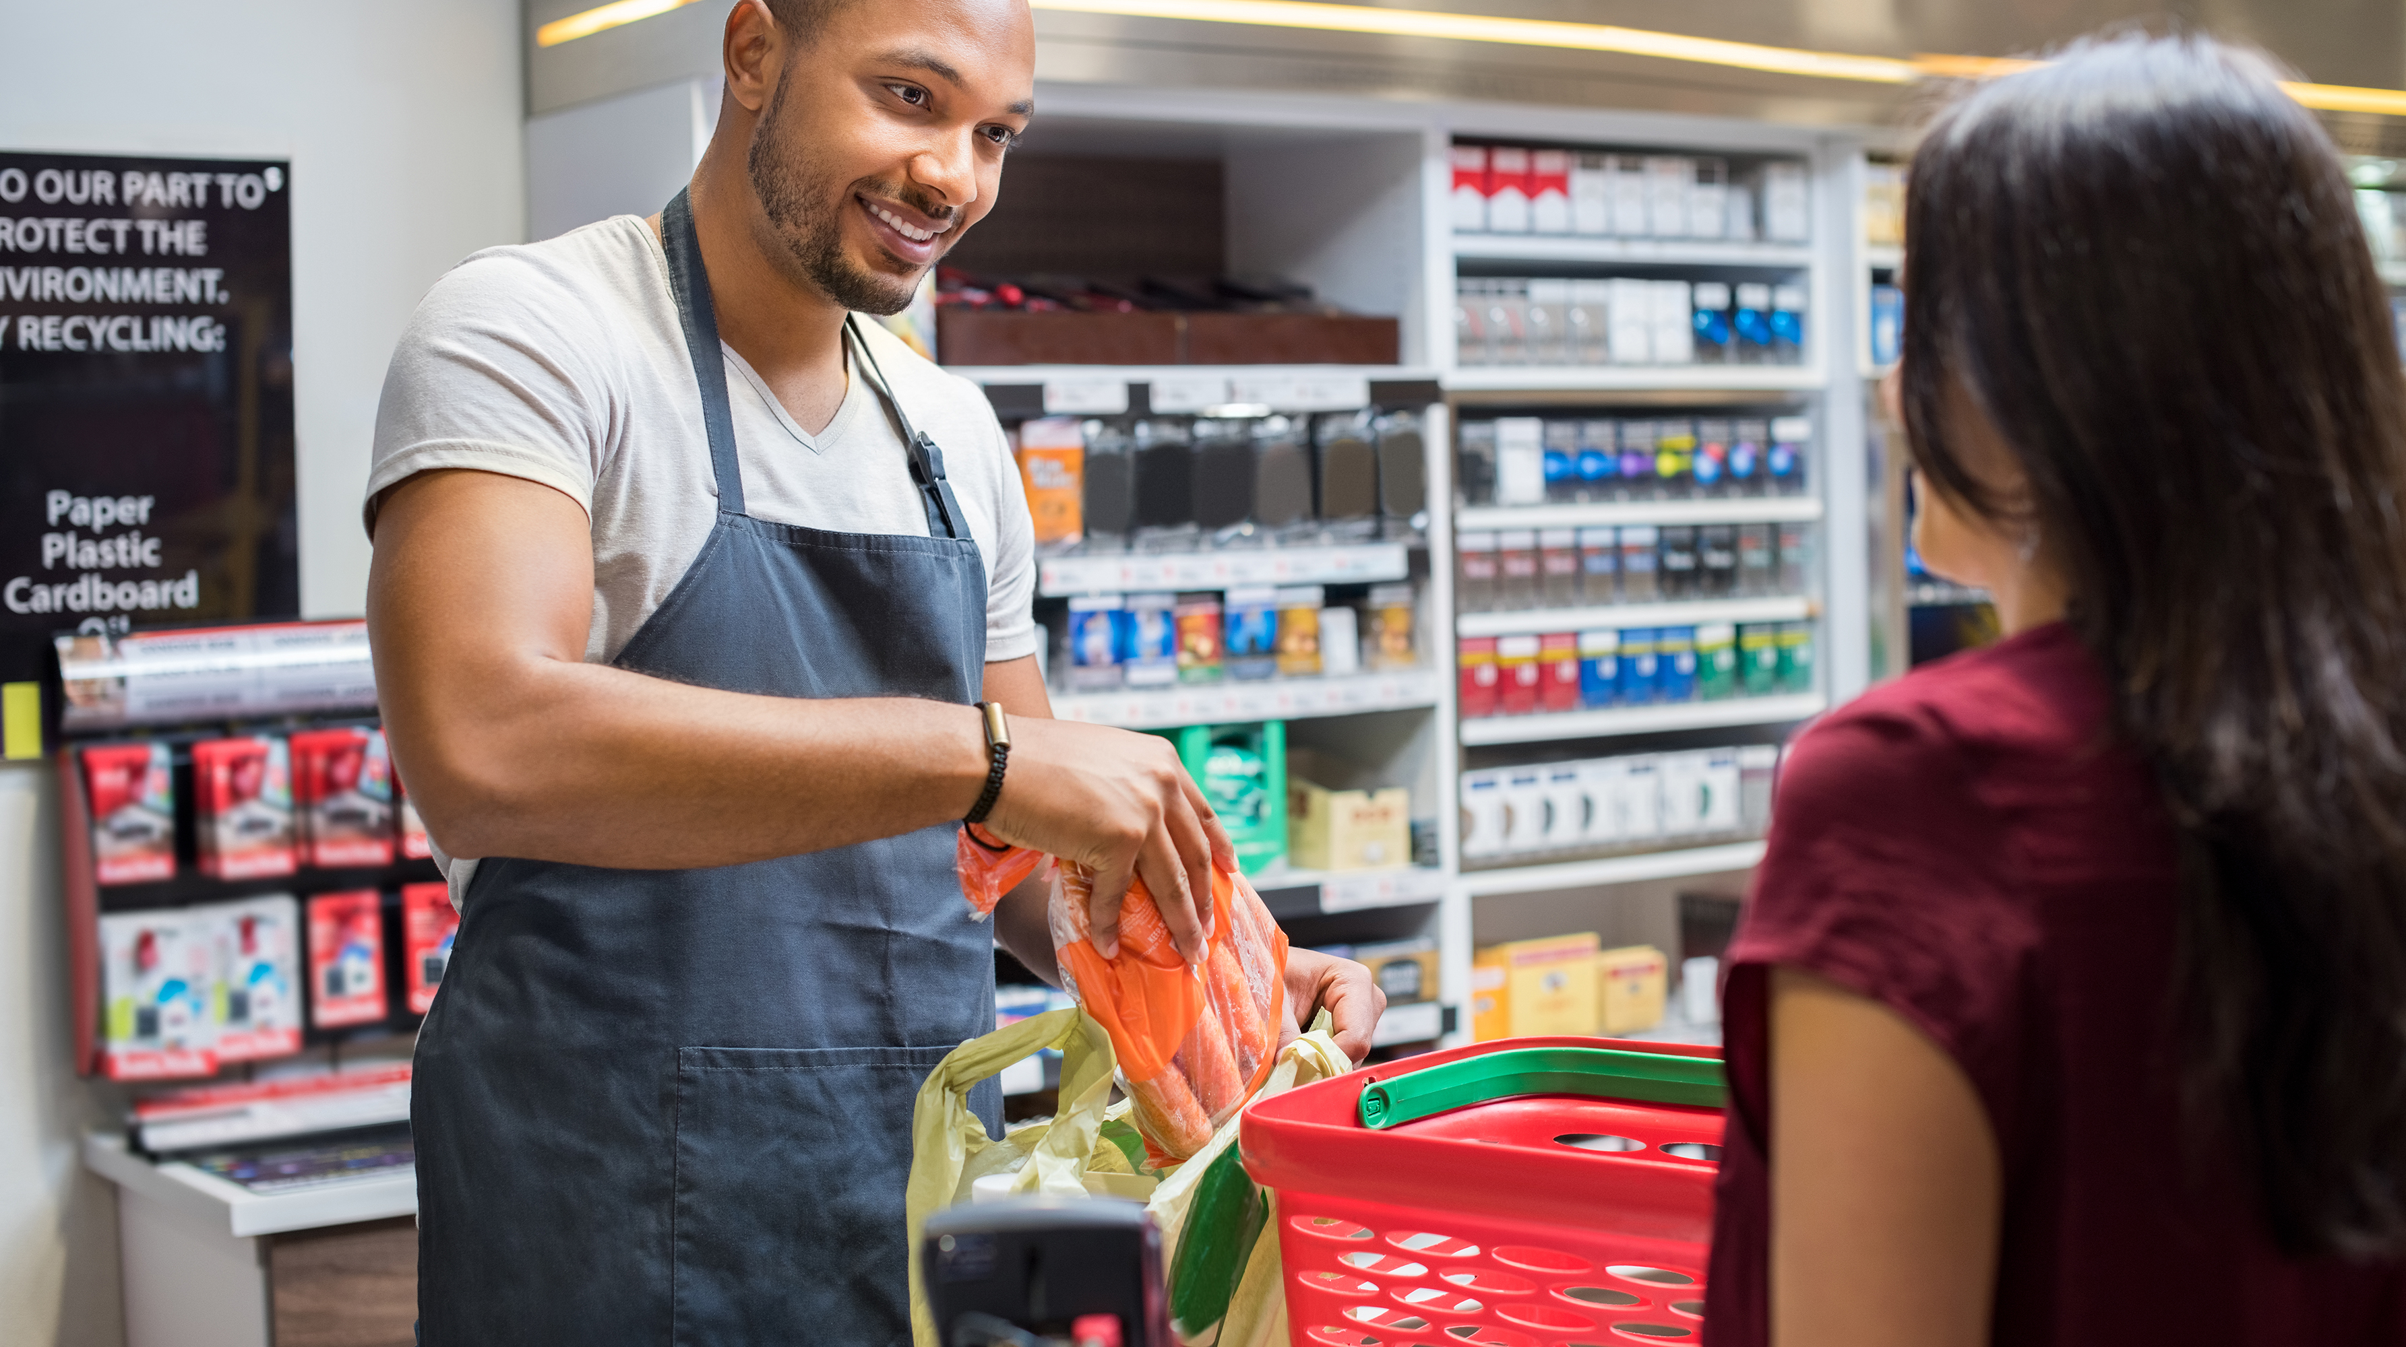
Learn More
Older Millennial
East South Central
$1.4M in revenue per store
One More Shopper
One More Trip
One More Dollar

Slide 11

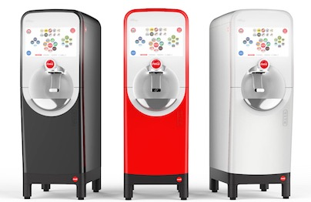
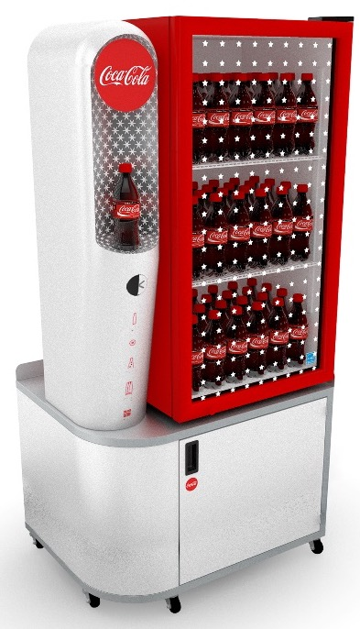
Older Millennial
East South Central
$1.4M in revenue per store
Adding +1 New Shopper
Examples of Activations
Per Store Per Month
$12,469 per store
Coca-Cola
Freestyle 9100
Coolers

Slide 12
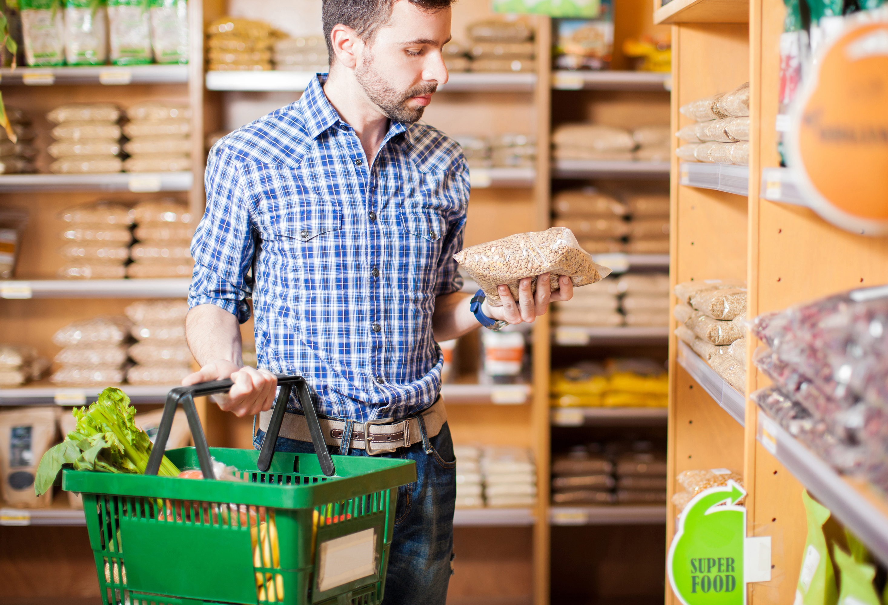
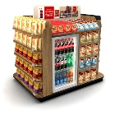
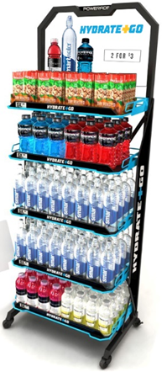
Older Millennial
East South Central
$1.4M in revenue per store
Adding +1 More Trip
Examples of Activations
Per Shopper Per Store Per Month
$12,531 per store
Snack Bundle
Hydration Rack

Slide 13
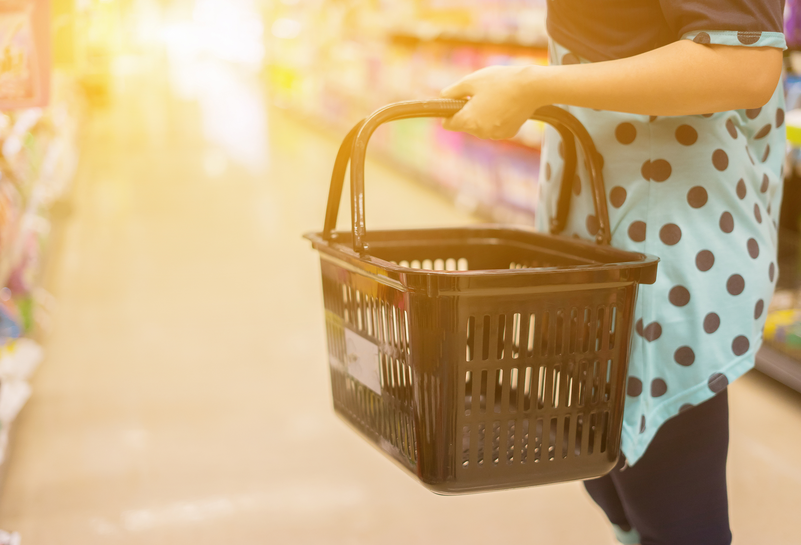
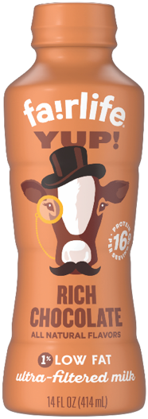
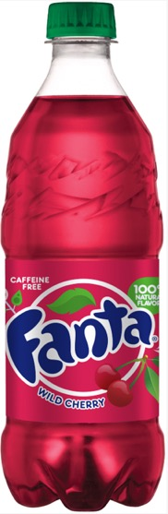



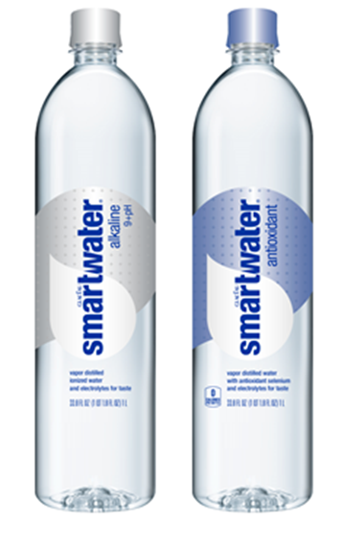
Older Millennial
East South Central
$1.4M in revenue per store
Adding +$1 to your basket
Examples of Activations
Per Store Per Year
$150,538 per store
Fairlife YUP!
Fanta
Dunkin Donuts
Smartwater

Slide 14
Learn More
Older Millennial
East South Central
$1.9M in revenue per store
One More Shopper
One More Trip
One More Dollar

Slide 15
Older Millennial
East South Central
$1.9M in revenue per store
Adding +1 New Shopper
Examples of Activations
Per Store Per Month
$12,469 per store
Coca-Cola
Freestyle 9100
Coolers

Slide 16
Older Millennial
East South Central
$1.9M in revenue per store
Adding +1 More Trip
Examples of Activations
Per Shopper Per Store Per Month
$17,006 per store
Snack Bundle
Hydration Rack

Slide 17
Older Millennial
East South Central
$1.9M in revenue per store
Adding +$1 to your basket
Examples of Activations
Per Store Per Year
$204,301 per store
Fairlife YUP!
Fanta
Dunkin Donuts
Smartwater

Slide 18
Learn More
Older Millennial
East South Central
$2.4M in revenue per store
One More Shopper
One More Trip
One More Dollar

Slide 19
Older Millennial
East South Central
$2.4M in revenue per store
Adding +1 New Shopper
Examples of Activations
Per Store Per Month
$12,469 per store
Coca-Cola
Freestyle 9100
Coolers

Slide 20
Older Millennial
East South Central
$2.4M in revenue per store
Adding +1 More Trip
Examples of Activations
Per Shopper Per Store Per Month
$21,481 per store
Snack Bundle
Hydration Rack

Slide 21
Older Millennial
East South Central
$2.4M in revenue per store
Adding +$1 to your basket
Examples of Activations
Per Store Per Year
$258,065 per store
Fairlife YUP!
Fanta
Dunkin Donuts
Smartwater

Slide 22
Learn More
Older Millennial
East South Central
$2.9M in revenue per store
One More Shopper
One More Trip
One More Dollar

Slide 23
Older Millennial
East South Central
$2.9M in revenue per store
Adding +1 New Shopper
Examples of Activations
Per Store Per Month
$12,469 per store
Coca-Cola
Freestyle 9100
Coolers

Slide 24
Older Millennial
East South Central
$2.9M in revenue per store
Adding +1 More Trip
Examples of Activations
Per Shopper Per Store Per Month
$25,956 per store
Snack Bundle
Hydration Rack

Slide 25
Older Millennial
East South Central
$2.9M in revenue per store
Adding +$1 to your basket
Examples of Activations
Per Store Per Year
$311,828 per store
Fairlife YUP!
Fanta
Dunkin Donuts
Smartwater

Slide 26
Learn More
Older Millennial
East South Central
$3.4M in revenue per store
One More Shopper
One More Trip
One More Dollar

Slide 27
Older Millennial
East South Central
$3.4M in revenue per store
Adding +1 New Shopper
Examples of Activations
Per Store Per Month
$12,469 per store
Coca-Cola
Freestyle 9100
Coolers

Slide 28
Older Millennial
East South Central
$3.4M in revenue per store
Adding +1 More Trip
Examples of Activations
Per Shopper Per Store Per Month
$30,431 per store
Snack Bundle
Hydration Rack

Slide 29
Older Millennial
East South Central
$3.4M in revenue per store
Adding +$1 to your basket
Examples of Activations
Per Store Per Year
$365,591 per store
Fairlife YUP!
Fanta
Dunkin Donuts
Smartwater

